Slide 1
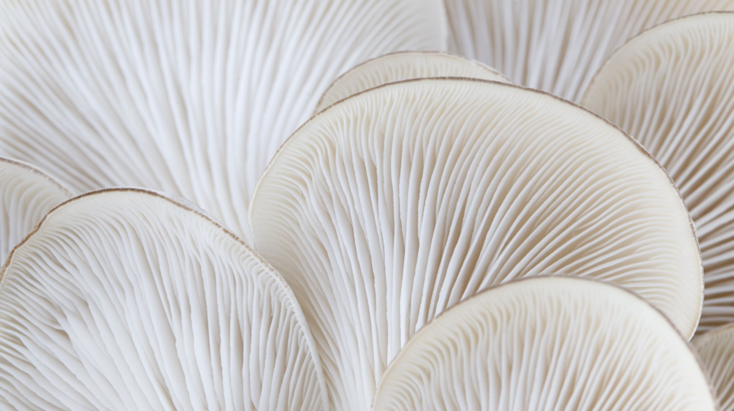
Mushroom Classification
Dominic Familette
Elvis Mitropoulos
Karthika Prasad
Nayoung Kim

Slide 2
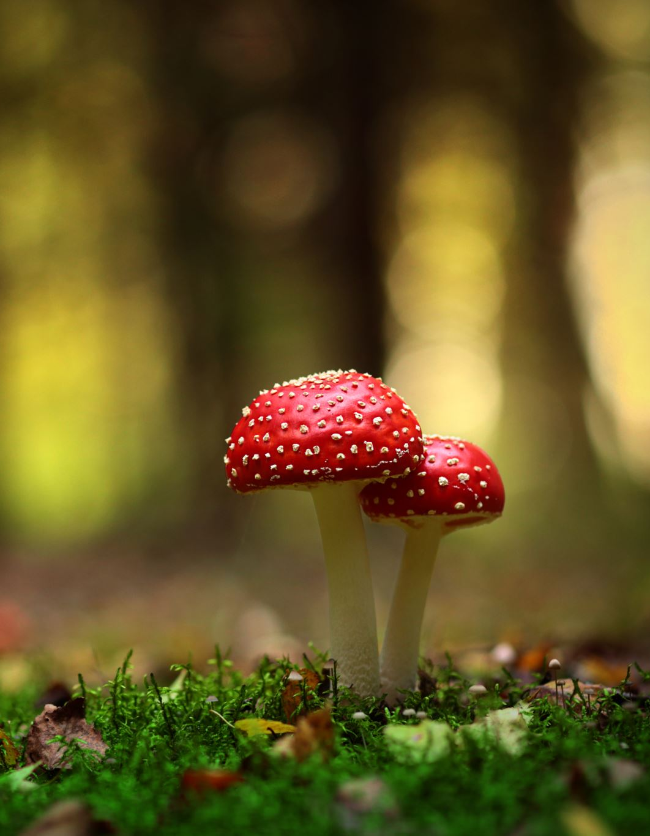
Mushrooms Dataset
Kaggle (https://www.kaggle.com/datasets/uciml/mushroom-classification/data)
Why?
Develop a model to classify poisonous/edible mushrooms given their features (i.e. veil color, gill size, bruises, and ring type)
Shape
8143 data observations of mushrooms
22 features variable that describe mushrooms
1 target variable that classes mushrooms – edible vs. poisonous.

Slide 3
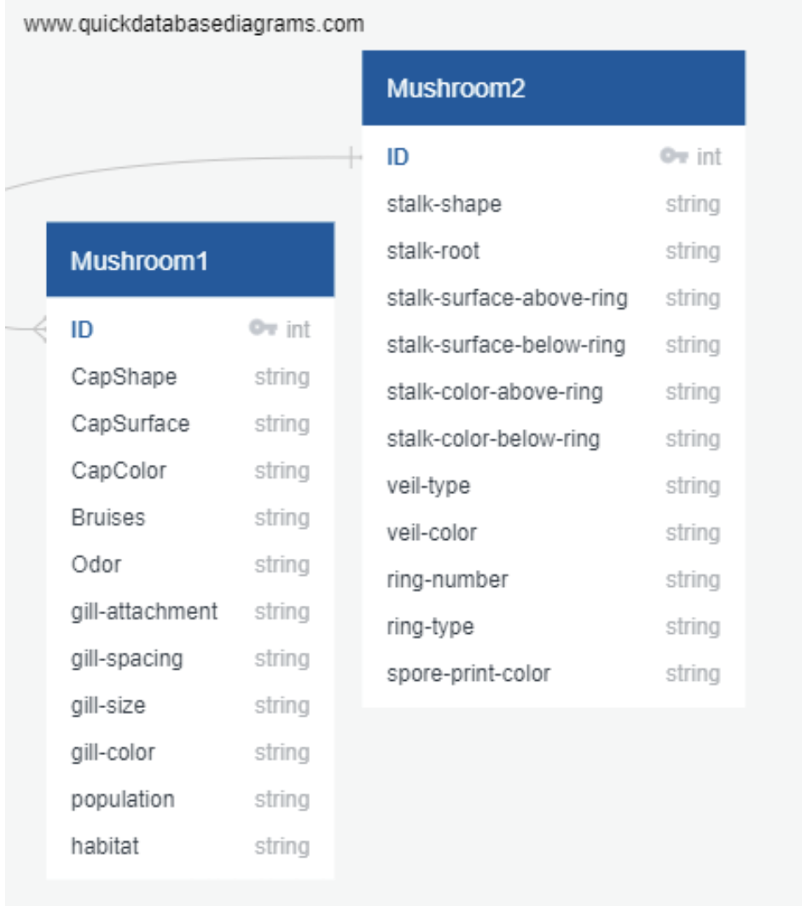
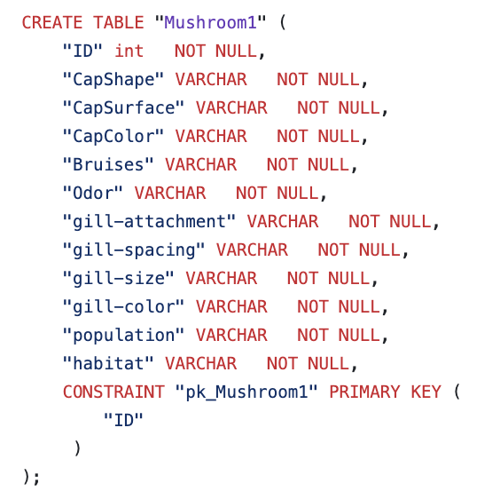
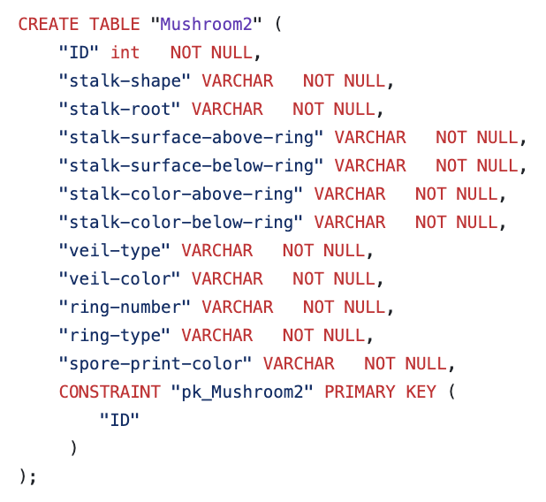
QuickDBD & PostgreSQL
Used Quick Database Diagrams
Created two tables in PostgreSQL

Slide 4
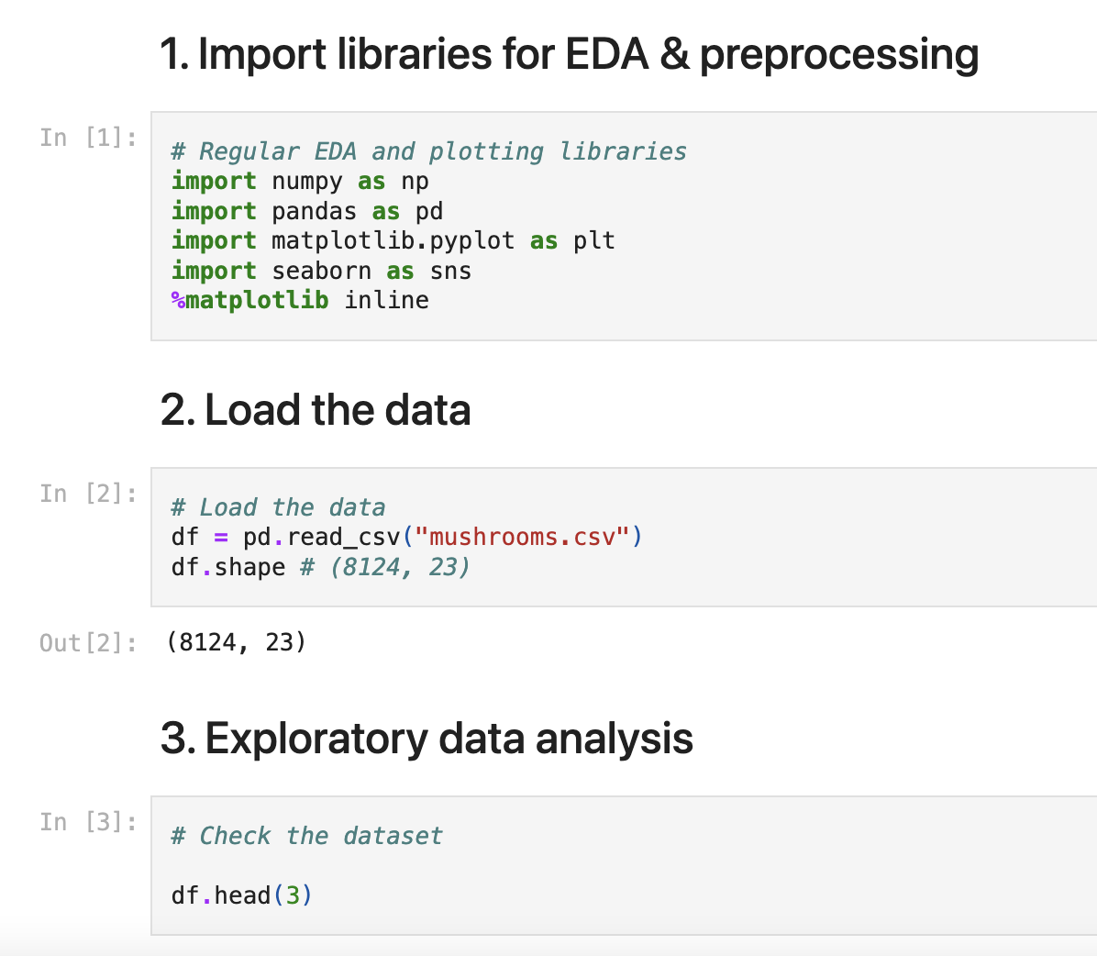
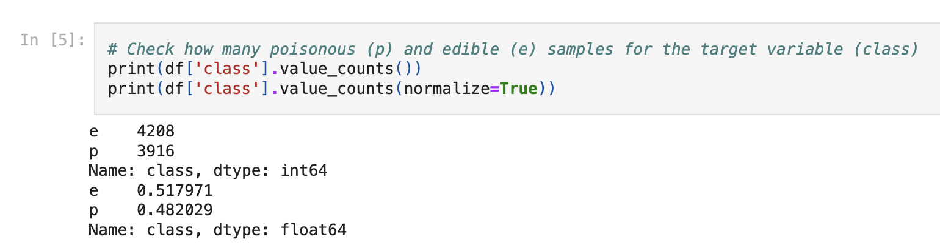
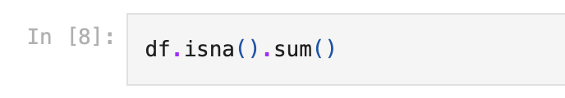
ML Modeling Framework EDA & Preprocessing
Import libs, load the data, check the data shape, and create bar graphs & corr heatmap
Check NA values and convert category values into numeric values
Check to see if the target variable is balanced between two classes

Slide 5
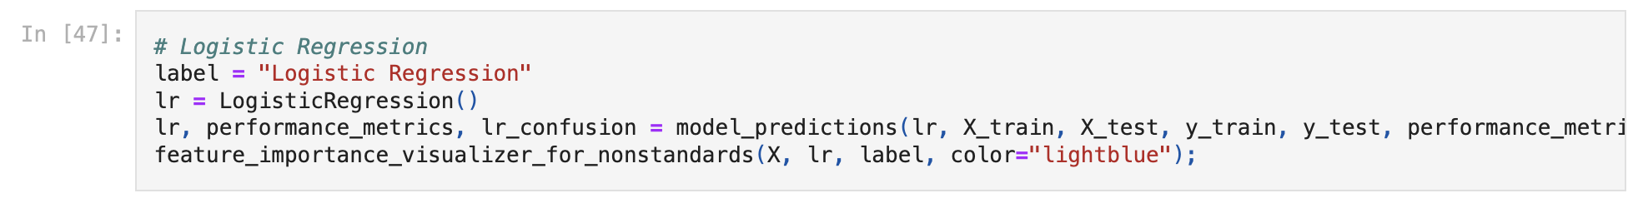
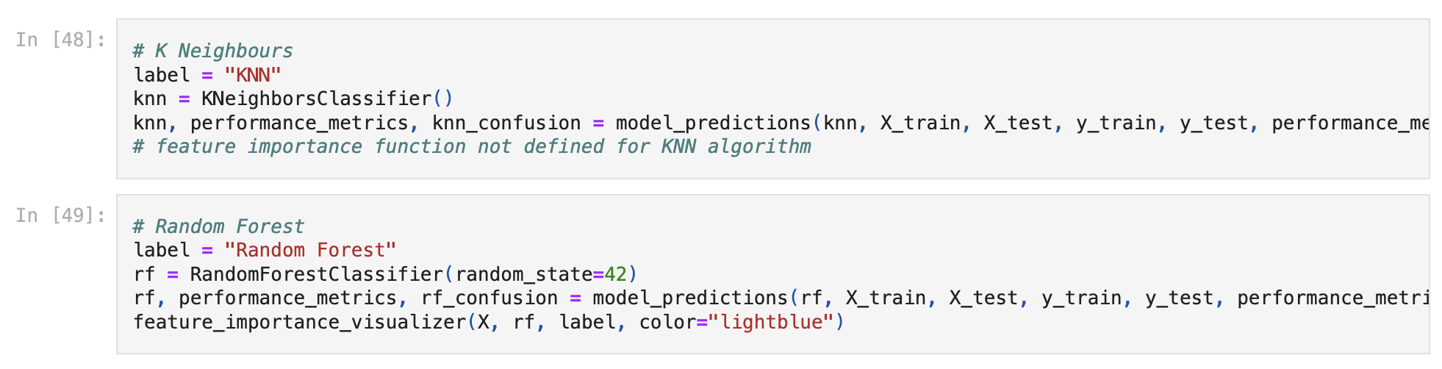
ML Modeling Framework Model Training
Model training
Logistic Regression with LogisticRegression()
K-NEarest Neighbors with KNeighboursClassifier()
RandomForest - RandomForestClassifier()

Slide 6
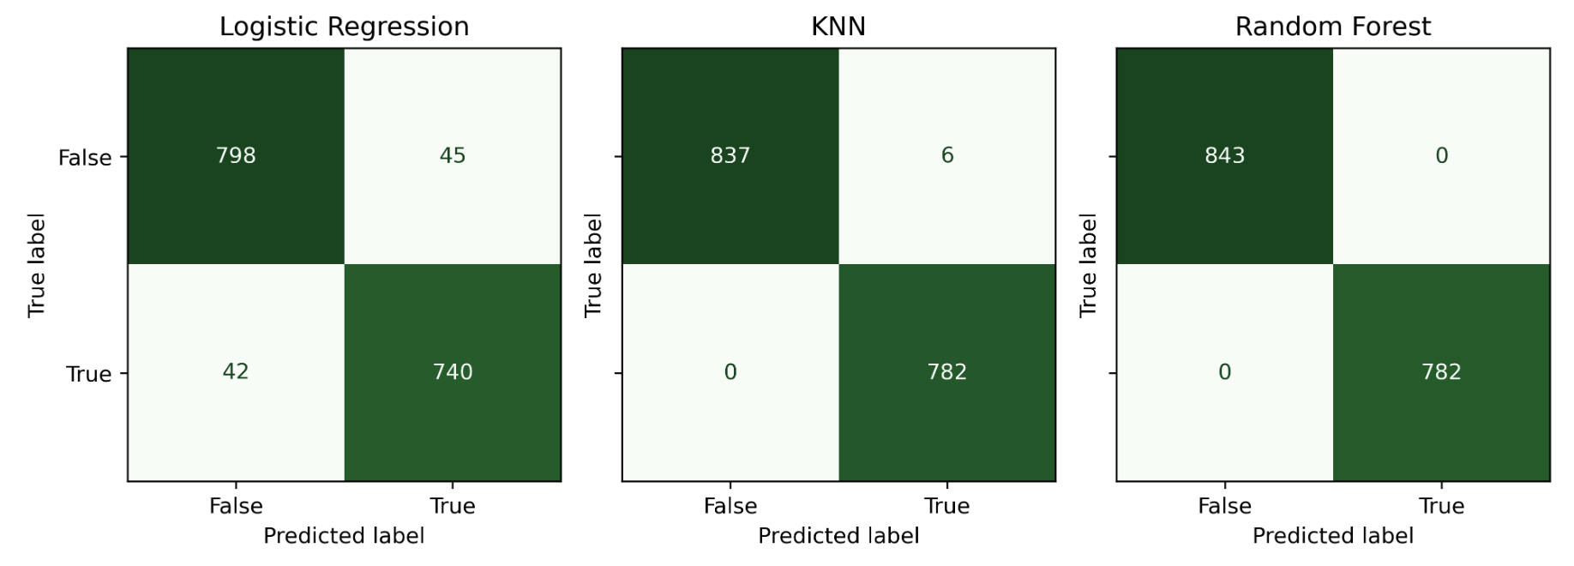
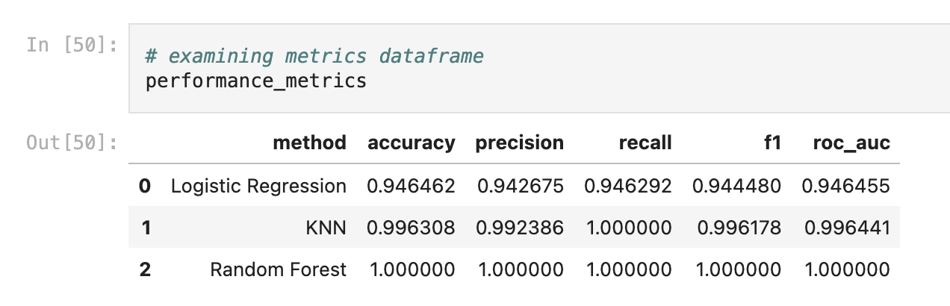
ML Modeling Framework Model Evaluation
Confusion Matrix
Accuracy
Precision
Recall
F1
ROC_AUC

Slide 7
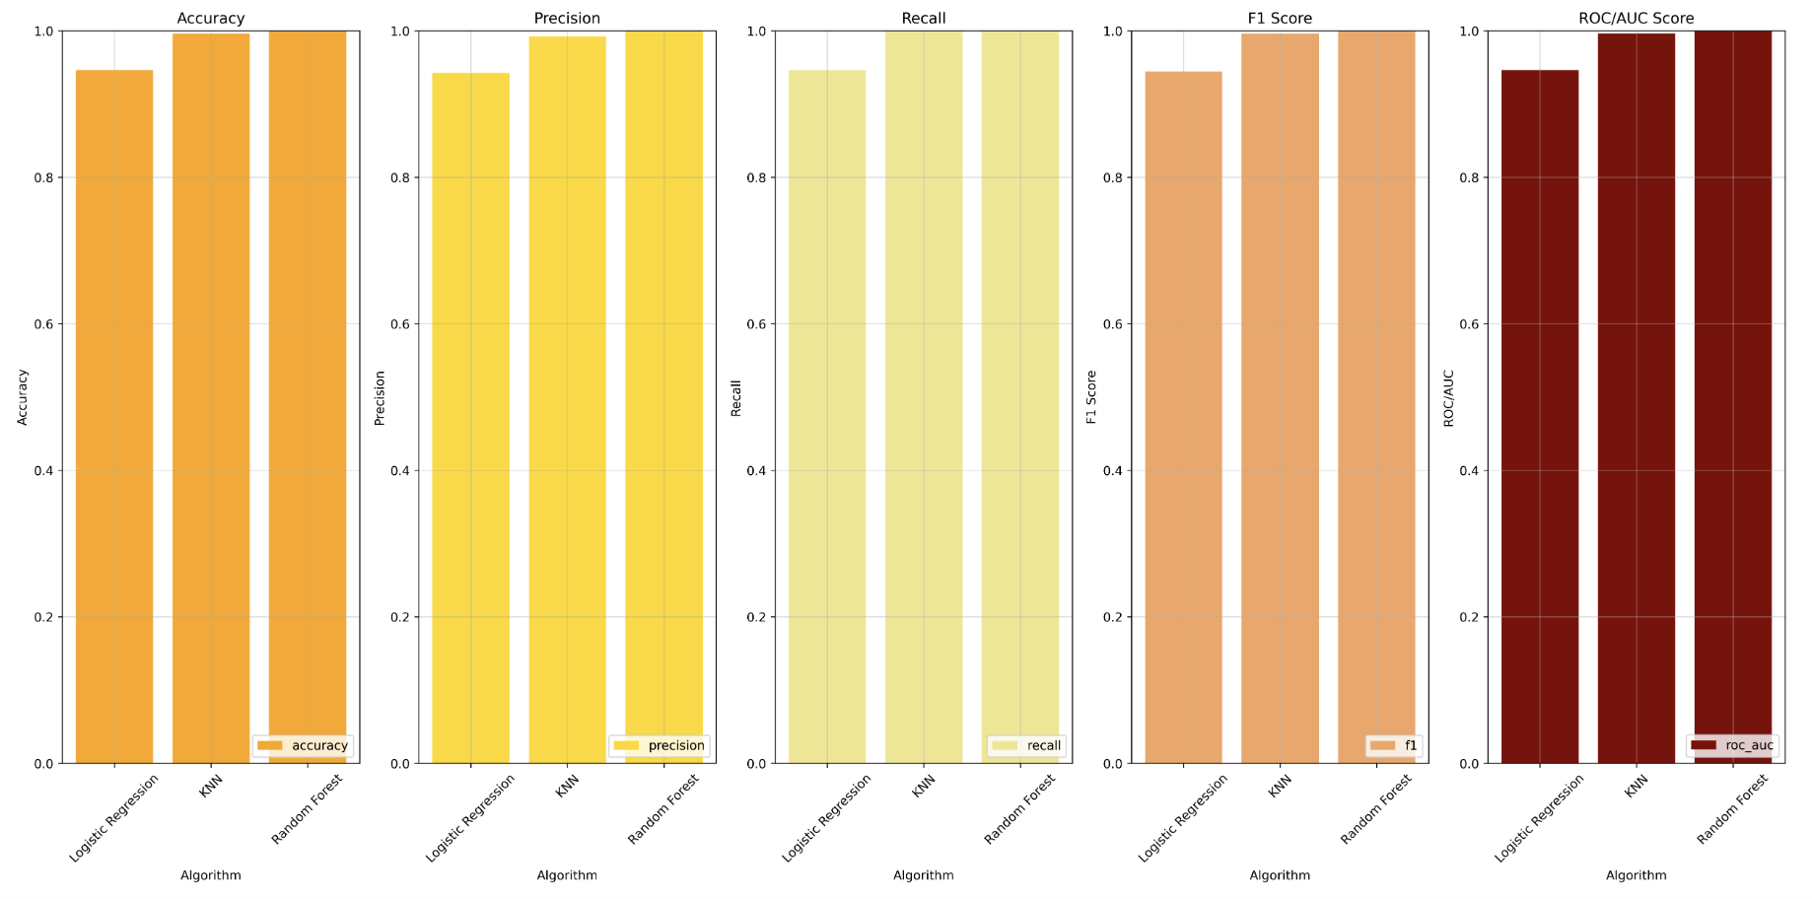
ML Modeling Framework Model Evaluation
Confusion Matrix
Accuracy
Precision
Recall
F1
ROC_AUC

Slide 8
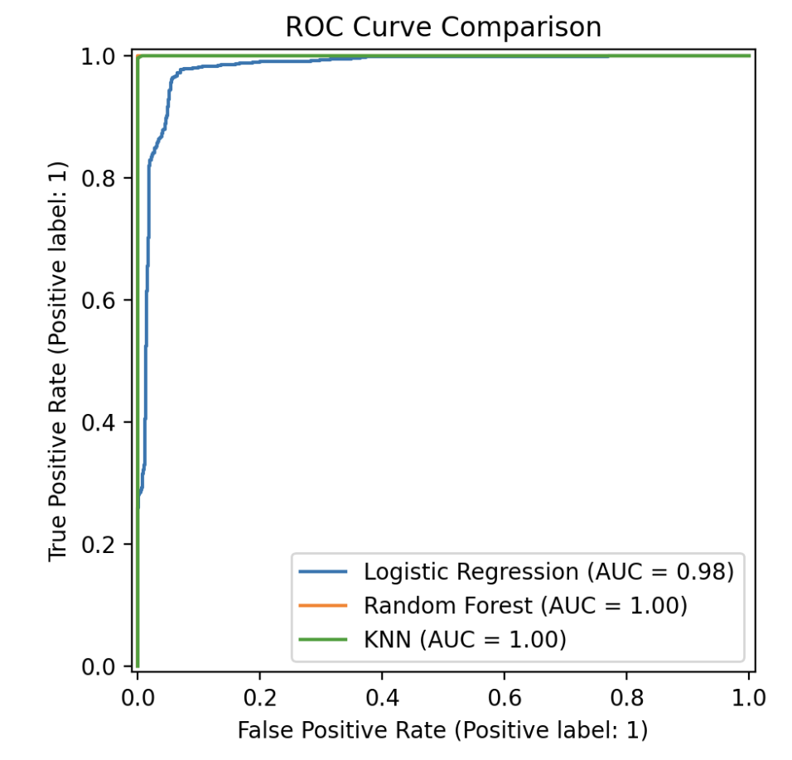
ML Modeling Framework Model Evaluation
Confusion Matrix
Accuracy
Precision
Recall
F1
ROC_AUC

Slide 9
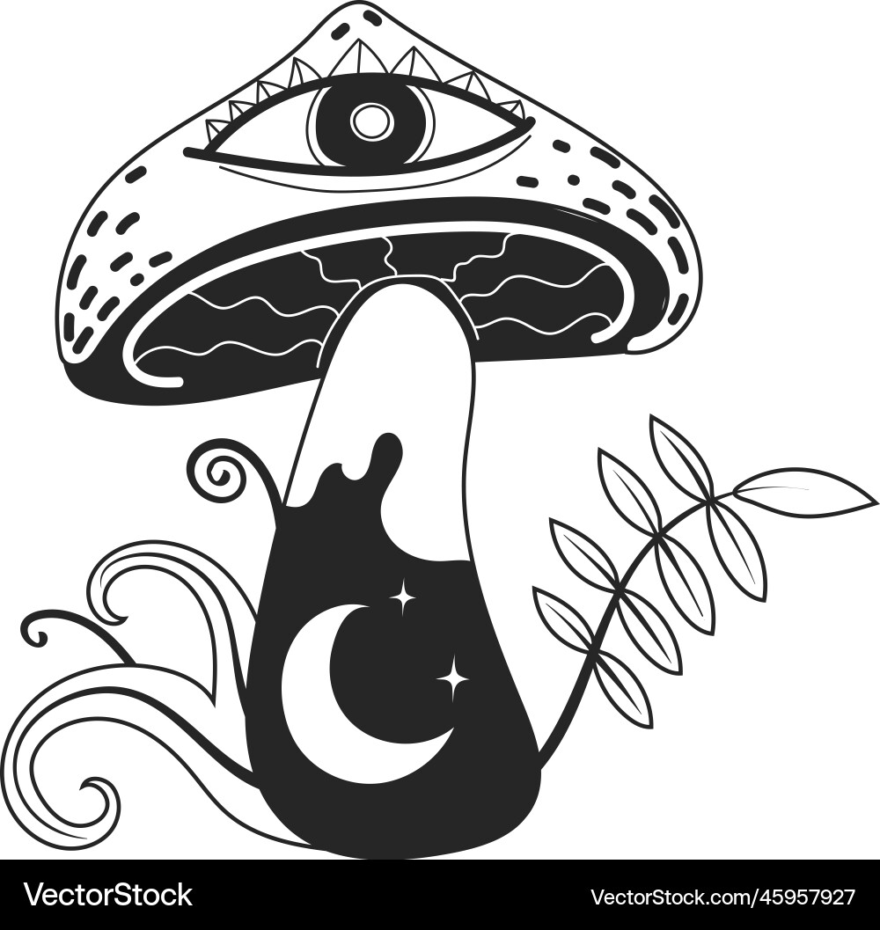
Mushroom Classification Website
Tech Stack
Frontend: HTML, CSS, JavaScript
Backend: Flask (Python)
Model: K-Nearest Neighbors (KNN)
Frontend Development
Create user interface with dropdown
Use CSS for styling and design
Implement JavaScript for handling user input
Backend Development
Set up Flask server to handle requests
Load pre-trained KNN model
Define routes for home page and prediction endpoint
Deployment
Deploy the web application on a cloud server
Then troubleshoot to make sure the application is accessible and functional

Slide 10

Limitations
What if we have incomplete data at prediction time?
Should we predict likelihood of inedibility?

Slide 11

Any Questions?

Slide 12
Thank you! ☺

